Slide 1
Verilog HDL introduction
Xuejun An
Institute of Computing Technology, CAS
axj@ict.ac.cn

Slide 2
Reference
David Culler, EECS 150 - Components and Design Techniques for Digital Systems
Ronald Fearing, EECS150 - Digital Design, http://www-inst.eecs.berkeley.edu/~cs150
Philip Levis, EE108A: Digital Systems I, http://web.stanford.edu/class/archive/ee/ee108a/ee108a.1082/
Verilog® HDL Quick Reference Guide, Sutherland HDL, Inc.
IEEE Std 1364-2001, IEEE Standard Verilog® Hardware Description Language, IEEE Computer Society, Sponsored by the Design Automation Standards Committee

Slide 3

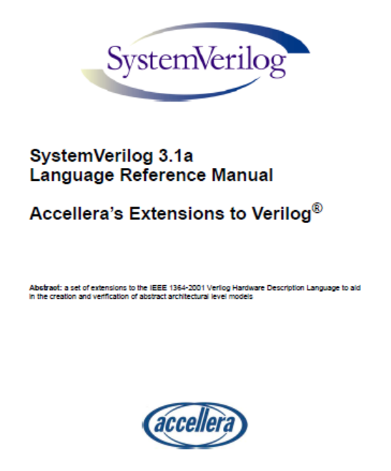
Quick History of HDLs
Originated at Automated Integrated Design Systems (renamed Gateway) in 1985. Acquired by Cadence in 1989.
Invented as simulation language. Synthesis was an afterthought. Many of the basic techniques for synthesis were developed at Berkeley in the 80’s and applied commercially in the 90’s.
Around the same time as the origin of Verilog, the US Department of Defense developed VHDL (A double acronym! VHSIC (Very High-Speed Integrated Circuit) HDL). Because it was in the public domain it began to grow in popularity.
Afraid of losing market share, Cadence opened Verilog to the public in 1990.
An IEEE working group was established in 1993, and ratified IEEE Standard 1394 (Verilog) in 1995. We use IEEE Std 1364-2001.
Verilog is the language of choice of Silicon Valley companies, initially because of high-quality tool support and its similarity to C-language syntax.
VHDL is still popular within the government, in Europe and Japan, and some Universities.
Most major CAD frameworks now support both.
Latest Verilog version is “system Verilog” .
Latest HDL: C++ based. OSCI (Open System C Initiative).
791 pages
586 pages

Slide 4
VERILOG vs. VHDL
VHDL: Uses top-down approach to partition design into small blocks ‘components’
Entity: describes interface signals & basic building blocks
Architecture: describes behavior, each entity can have multiple Architectures
Configuration: sort of parts list for a design, which behavior to use for each entity.
Package: toolbox used to build design
Verilog: one building block
Module: modules connect through their port similarly as in VHDL
Usually there is only one module per file.
A top level invokes instances of other modules.
Modules can be specified behaviorally or structurally.
Behavioral specification defines behavior of digital system
Structural specification defines hierarchical interconnection of sub modules

Slide 5
Similarities
These languages have taken designers from low level detail to much higher level of abstraction.
In 2000 VI & OVI merged into Accellera (http://www.accellera.org/about )
Simulation & synthesis are the two main kinds of tools which operate on the VHDL & Verilog languages.
They are not a toolset or methodology they are each a different language.
However toolsets and methodologies are essential for their effective use.
Latest languages: SystemC, Universal Verification Methodology (UVM), and IP-XACT

Slide 6
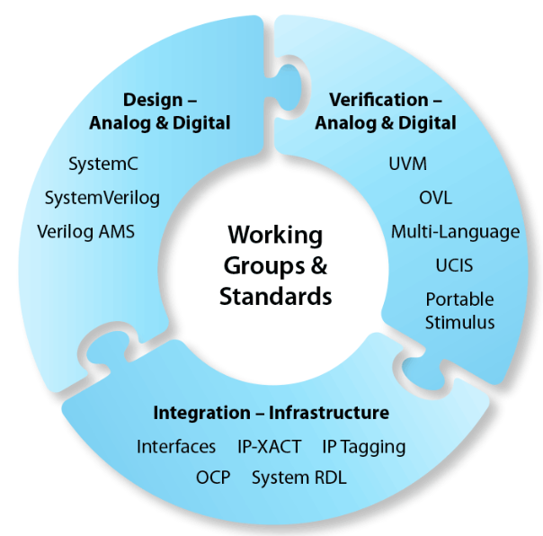
The Accellera Ecosystem

Slide 7
Differences?
There are not many differences as to the capabilities of each.
The choice of which one to use is often based in personal preference & other issues such as availability of tools & commercial terms.
VHDL is “harder” to learn ADA-like.
Verilog is “easier” to learn C-like.

Slide 8
Review
Advancing technology changes the trade-offs and design techniques
2x transistors per chip every 18 months
ASIC, Programmable Logic, Microprocessor
Programmable logic invests chip real-estate to reduce design time & time to market
Canonical Forms, Logic Minimization, PLAs, →
FPGA:
programmable interconnect,
configurable logic blocks
LUT + storage
Block RAM
IO Blocks

Slide 9
Outline
Netlists
Design flow
What is a HDL?
Verilog
Announcements
Structural models
Behavioral models
Elements of the language
Lots of examples

Slide 10
Remember: to design is to represent
How do we represent digital designs?
Components
Logic symbol, truth table
Storage symbol, timing diagram
Connections
Schematics
Human readable or machine readable???

Slide 11
Design Flow
Requirements
Design
Entry
RTL Model
Simulate
High-level
Analysis
Synthesize
Gate-level Model
Simulate
Test Bench
Technology
Mapping
ASIC or FPGA
Place & Route
Low-level
Analysis
Timing Model
Simulate

Slide 12
Netlist
Alternative format:
n1 g1.in1
n2 g1.in2
n3 g2.in1
n4 g2.in2
n5 g1.out g3.in1
n6 g2.out g3.in2
n7 g3.out
g1 "and"
g2 "and"
g3 "or"
A key data structure (or representation) in the design process is the “netlist”:
Network List
A netlist lists components and connects them with nodes:
ex:
g1 "and" n1 n2 n5
g2 "and" n3 n4 n6
g3 "or" n5 n6 n7
Netlist is needed for simulation and implementation.
Could be at the transistor level, gate level, ...
Could be hierarchical or flat.
How do we generate a netlist?

Slide 13
Design Flow
Design
Entry
Circuit is described and represented:
Graphically (Schematics)
Textually (HDL)
Result of circuit specification (and compilation) is a netlist of:
generic primitives - logic gates, flip-flops, or
technology specific primitives - LUTs/CLBs, transistors, discrete gates, or
higher level library elements - adders, ALUs, register files, decoders, etc.
High-level
Analysis
Technology
Mapping
Low-level
Analysis

Slide 14
Design Flow
High-level Analysis is used to verify:
correct function
rough:
timing
power
cost
Common tools used are:
simulator - check functional correctness, and
static timing analyzer
estimates circuit delays based on timing model and delay parameters for library elements (or primitives).
Design
Entry
High-level
Analysis
Technology
Mapping
Low-level
Analysis

Slide 15
Design Flow
Design
Entry
Technology Mapping:
Converts netlist to implementation technology dependent details
Expands library elements,
performs:
partitioning,
placement,
routing
Low-level Analysis
Simulation and Analysis Tools perform low-level checks with:
accurate timing models,
wire delay
For FPGAs this step could also use the actual device
High-level
Analysis
Technology
Mapping
Low-level
Analysis

Slide 16
Design Flow
Design
Entry
High-level
Analysis
Netlist:
used between and
internally for all steps.
Technology
Mapping
Low-level
Analysis

Slide 17
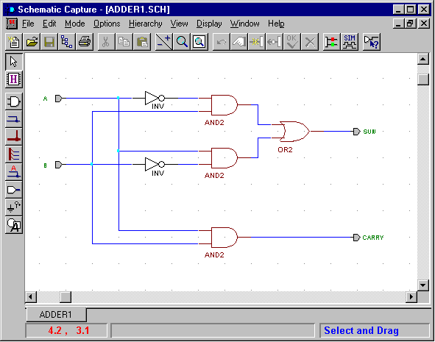
Design Entry
Schematic entry/editing used to be the standard method in industry
Schematics are intuitive. They match our use of gate-level or block diagrams.
Somewhat physical. They imply a physical implementation.
Require a special tool (editor).
Unless hierarchy is carefully designed, schematics can be confusing and difficult to follow.
Hardware Description Languages (HDLs) are the new standard
except for PC board design, where schematics are still used.

Slide 18
HDLs
“Structural” example:
Decoder(output x0,x1,x2,x3;
inputs a,b)
{
wire abar, bbar;
inv(bbar, b);
inv(abar, a);
nand(x0, abar, bbar);
nand(x1, abar, b );
nand(x2, a, bbar);
nand(x3, a, b );
}
“Behavioral” example:
Decoder(output x0,x1,x2,x3;
inputs a,b)
{
case [a b]
00: [x0 x1 x2 x3] = 0x0;
01: [x0 x1 x2 x3] = 0x2;
10: [x0 x1 x2 x3] = 0x4;
11: [x0 x1 x2 x3] = 0x8;
endcase;
}
Basic Idea:
Language constructs describe circuits with two basic forms:
Structural descriptions similar to hierarchical netlist.
Behavioral descriptions use higher-level constructs (similar to conventional programming).
Originally designed to help in abstraction and simulation.
Now “logic synthesis” tools exist to automatically convert from behavioral descriptions to gate netlist.
Greatly improves designer productivity.
However, this may lead you to falsely believe that hardware design can be reduced to writing programs

Slide 19
Design Methodology
Structure and Function (Behavior) of a Design
HDL Specification
Simulation
Synthesis
Verification: Design
Behave as Required?
Functional: I/O Behavior
Register-Level (Architectural)
Logic-Level (Gates)
Transistor-Level (Electrical)
Timing: Waveform Behavior
Generation: Map
Specification to
Implementation

Slide 20
Verilog Introduction
the module describes a component in the circuit
Two ways to describe:
Structural Verilog
List of components and how they are connected
Just like schematics, but using text
A net list
tedious to write, hard to decode
Essential without integrated design tools
Behavioral Verilog
Describe what a component does, not how it does it
Synthesized into a circuit that has this behavior
Result is only as good as the tools
Build up a hierarchy of modules

Slide 21
Structural Model - XOR
module name
port list
module xor_gate ( out, a, b ); input a, b; output out; wire abar, bbar, t1, t2; inverter invA (abar, a); inverter invB (bbar, b); and_gate and1 (t1, a, bbar); and_gate and2 (t2, b, abar); or_gate or1 (out, t1, t2);
endmodule
declarations
Built-in gates
A
statements
t1
and1
out
invA
or1
B
and2
t2
invB
Instance name
interconnections
Composition of primitive gates to form more complex module
Note use of wire declaration!
By default, identifiers are wires

Slide 22
Structural Model: 2-to1 mux
Notes:
comments
“module”
port list
declarations
wire type
primitive gates
Instance names?
List per type
//2-input multiplexor in gates
module mux2 (in0, in1, select, out);
input in0,in1,select;
output out;
wire s0,w0,w1;
not (s0, select);
and (w0, s0, in0),
(w1, select, in1);
or (out, w0, w1);
endmodule // mux2
in1
w1
s0
out
select
in0
w0

Slide 23
Simple Behavioral Model
Combinational logic
Describe output as a function of inputs
Note use of assign keyword: continuous assignment
Output port of a primitive must be first in the list of ports
Restriction does not apply to modules in general
module and_gate (out, in1, in2); input in1, in2; output out;
assign out = in1 & in2;
endmodule
When is this “evaluated”?

Slide 24
2-to-1 mux behavioral description
// Behavioral model of 2-to-1
// multiplexor.
module mux2 (in0,in1,select,out);
input in0,in1,select;
output out;
//
reg out;
always @ (in0 or in1 or select)
if (select) out=in1;
else out=in0;
endmodule // mux2
Notes:
behavioral descriptions using keyword always followed by blocking procedural assignments
Target output of procedural assignments must of of type reg
(not a real register)
Unlike wire types where the target output of an assignment may be continuously updated, a reg type retains it value until a new value is assigned (the assigning statement is executed).
Optional initial statement
Sensitivity list

Slide 25
Behavioral 4-to1 mux
//Does not assume that we have
// defined a 2-input mux.
//4-input mux behavioral description
module mux4 (in0, in1, in2, in3, select, out);
input in0,in1,in2,in3;
input [1:0] select;
output out;
reg out;
always @ (in0 in1 in2 in3 select)
case (select)
2’b00: out=in0;
2’b01: out=in1;
2’b10: out=in2;
2’b11: out=in3;
endcase
endmodule // mux4
Notes:
No instantiation
Case construct equivalent to nested if constructs.
Definition: A structural description is one where the function of the module is defined by the instantiation and interconnection of sub-modules.
A behavioral description uses higher level language constructs and operators.
Verilog allows modules to mix both behavioral constructs and sub-module instantiation.

Slide 26
Mixed Structural/Behavioral Model
Example 4-bit ripple adder
module full_addr (S, Cout, A, B, Cin );
input A, B, Cin;
output S, Cout;
assign {Cout, S} = A + B + Cin;
endmodule
Behavior
module adder4 (S, Cout, A, B, Cin);
input [3:0] A, B;
input Cin;
output [3:0] S;
output Cout;
wire C1, C2, C3;
full_addr fa0 (S[0], C1, A[0], B[0], Cin);
full_addr fa1 (S[1], C2, A[1], B[1], C1);
full_addr fa2 (S[2], C3, A[2], B[2], C2);
full_addr fa3 (S[3], Cout, A[3], B[3], C3);
endmodule
Structural
Order of ports?

Slide 27
Verilog Data Types and Values
Bits - value on a wire
0, 1
X - don’t care/don’t know
Z - undriven, tri-state
Vectors of bits
A[3:0] - vector of 4 bits: A[3], A[2], A[1], A[0]
Treated as an unsigned integer value
e.g. , A < 0 ??
Concatenating bits/vectors into a vector
e.g., sign extend
B[7:0] = {A[3], A[3], A[3], A[3], A[3:0]};
B[7:0] = {3{A[3]}, A[3:0]};
Style: Use a[7:0] = b[7:0] + c; Not: a = b + c; // need to look at declaration

Slide 28
Verilog Numbers
14 - ordinary decimal number
-14 - 2’s complement representation
12’b0000_0100_0110 - binary number with 12 bits (_ is ignored)
12’h046 - hexadecimal number with 12 bits
Verilog values are unsigned
e.g., C[4:0] = A[3:0] + B[3:0];
if A = 0110 (6) and B = 1010(-6) C = 10000 not 00000 i.e., B is zero-padded, not sign-extended

Slide 29
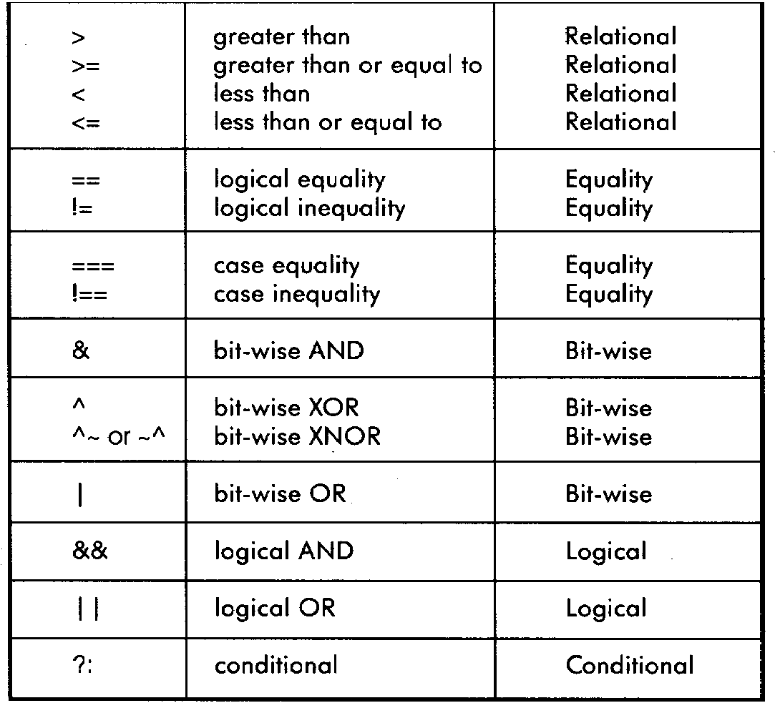
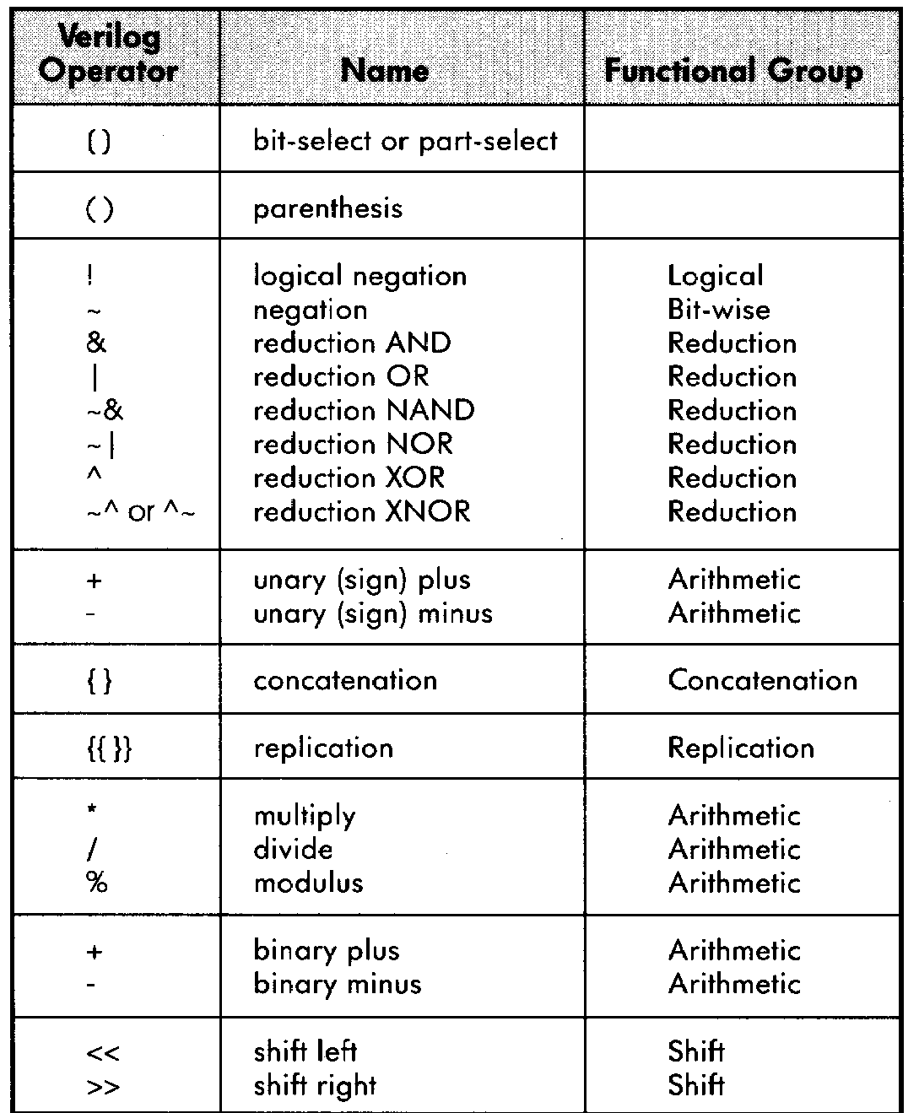
Verilog Operators

Slide 30
Verilog Variables
wire
Variable used simply to connect components together
reg
Variable that saves a value as part of a behavioral description
Usually corresponds to a wire in the circuit
Is NOT necessarily a register in the circuit
usage:
Don’t confuse reg assignments with the combinational continuous assign statement! (more soon)
Reg should only be used with always blocks (sequential logic, to be presented …)

Slide 31
Verilog Module
Corresponds to a circuit component
“Parameter list” is the list of external connections, aka “ports”
Ports are declared “input”, “output” or “inout”
inout ports used on tri-state buses
Port declarations imply that the variables are wires
A
B
Cin
module name
ports
module full_addr (A, B, Cin, S, Cout); input A, B, Cin; output S, Cout; assign {Cout, S} = A + B + Cin; endmodule
Cout
S
inputs/outputs

Slide 32
Verilog Continuous Assignment
Assignment is continuously evaluated
assign corresponds to a connection or a simple component with the described function
Target is NEVER a reg variable
Dataflow style
use of Boolean operators (~ for bit-wise, ! for logical negation)
assign A = X | (Y & ~Z);
assign B[3:0] = 4'b01XX;
assign C[15:0] = 4'h00ff;
assign #3 {Cout, S[3:0]} = A[3:0] + B[3:0] + Cin;
bits can take on four values (0, 1, X, Z)
variables can be n-bits wide (MSB:LSB)
use of arithmetic operator
multiple assignment (concatenation)
delay of performing computation, only used by simulator, not synthesis

Slide 33
Comparator Example
module Compare1 (A, B, Equal, Alarger, Blarger); input A, B; output Equal, Alarger, Blarger; assign Equal = (A & B) | (~A & ~B); assign Alarger = (A & ~B); assign Blarger = (~A & B);
endmodule
When evaluated?
What is synthesized?

Slide 34
Comparator Example
// Make a 4-bit comparator from 4 1-bit comparators module Compare4(A4, B4, Equal, Alarger, Blarger); input [3:0] A4, B4; output Equal, Alarger, Blarger; wire e0, e1, e2, e3, Al0, Al1, Al2, Al3, B10, Bl1, Bl2, Bl3; Compare1 cp0(A4[0], B4[0], e0, Al0, Bl0); Compare1 cp1(A4[1], B4[1], e1, Al1, Bl1); Compare1 cp2(A4[2], B4[2], e2, Al2, Bl2); Compare1 cp3(A4[3], B4[3], e3, Al3, Bl3); assign Equal = (e0 & e1 & e2 & e3); assign Alarger = (Al3 | (Al2 & e3) |
(Al1 & e3 & e2) |
(Al0 & e3 & e2 & e1)); assign Blarger = (~Alarger & ~Equal); endmodule
What would be a “better” behavioral version?

Slide 35
Simple Behavioral Model - the always block
always block
Always waiting for a change to a trigger signal
Then executes the body
module and_gate (out, in1, in2); input in1, in2; output out; reg out; always @(in1 or in2) begin
out = in1 & in2;
end
endmodule
Not a real register!!
A Verilog register
Needed because of
assignment in always block
Specifies when block is executed I.e., triggered by which signals

Slide 36
always Block
A procedure that describes the function of a circuit
Can contain many statements including if, for, while, case
Statements in the always block are executed sequentially
“blocking” assignment
Continuous assignments <= are executed in parallel
Non-blocking
The entire block is executed ‘at once’
But the meaning is established by sequential interpretation
Simulation micro time vs macro time
synthesis
The final result describes the function of the circuit for current set of inputs
intermediate assignments don’t matter, only the final result
begin/end used to group statements

Slide 37
What Verilog generates storage elements?
Expressions produce combinational logic
Map inputs to outputs
Storage elements carries same values forward in time

Slide 38
State Example
module shifter (in, A,B,C,clk);
input in, clk;
input A,B,C;
reg A, B, C;
always @ (posedge clk) begin
C = B;
B = A;
A = in;
end
endmodule
in
A
B
C
clk
Block interpreted sequentially,
but action happens “at once”

Slide 39
State Example2 – Non blocking
module shifter (in, A,B,C,clk);
input in, clk;
input A,B,C;
reg A, B, C;
always @ (posedge clk) begin
B <= A;
A <= in;
C <= B;
end
endmodule
in
A
B
C
clk
Non-blocking: all statements interpreted in parallel
Everything on the RHS evaluated,
Then all assignments performed

Slide 40
State Example2 – interactive quiz
module shifter (in, A,B,C,clk);
input in, clk;
input A,B,C;
reg A, B, C;
always @ (posedge clk) begin
A = in;
B = A;
C = B;
end
endmodule
Variable becomes a storage element if its value is preserved (carried forward in time) despite changes in variables the produce it.
Not whether it is declared as a wire or a reg!
in
A
B
C
clk

Slide 41
“Complete” Assignments
If an always block executes, and a variable is not assigned
Variable keeps its old value (think implicit state!)
NOT combinational logic ⇒ latch is inserted (implied memory)
This is usually not what you want: dangerous for the novice!
Any variable assigned in an always block should be assigned for any (and every!) execution of the block.

Slide 42
Incomplete Triggers
Leaving out an input trigger usually results in a sequential circuit
Example: The output of this “and” gate depends on the input history
module and_gate (out, in1, in2); input in1, in2; output out; reg out; always @(in1) begin
out = in1 & in2;
end
endmodule
What Hardware would this generate?

Slide 43
Behavioral with Bit Vectors
//Behavioral model of 32-bitwide 2-to-1 multiplexor.
module mux32 (in0,in1,select,out);
input [31:0] in0,in1;
input select;
output [31:0] out;
//
reg [31:0] out;
always @ (in0 or in1 or select)
if (select) out=in1;
else out=in0;
endmodule // Mux
//Behavioral model of 32-bit adder.
module add32 (S,A,B);
input [31:0] A,B;
output [31:0] S;
reg [31:0] S;
always @ (A or B)
S = A + B;
endmodule // Add
Notes:
inputs, outputs 32-bits wide

Slide 44
Hierarchy & Bit Vectors
//Assuming we have already
// defined a 2-input mux (either
// structurally or behaviorally,
//4-input mux built from 3 2-input muxes
module mux4 (in0, in1, in2, in3, select, out);
input in0,in1,in2,in3;
input [1:0] select;
output out;
wire w0,w1;
mux2
m0 (.select(select[0]), .in0(in0), .in1(in1), .out(w0)),
m1 (.select(select[0]), .in0(in2), .in1(in3), .out(w1)),
m3 (.select(select[1]), .in0(w0), .in1(w1), .out(out));
endmodule // mux4
Notes:
instantiation similar to primitives
select is 2-bits wide
named port assignment

Slide 45
Verilog if
Same syntax as C if statement
Sequential meaning, action “at once”
// Simple 4-1 mux
module mux4 (sel, A, B, C, D, Y);
input [1:0] sel; // 2-bit control signal
input A, B, C, D;
output Y;
reg Y; // target of assignment
always @(sel or A or B or C or D)
if (sel == 2’b00) Y = A;
else if (sel == 2’b01) Y = B;
else if (sel == 2’b10) Y = C;
else if (sel == 2’b11) Y = D;
endmodule

Slide 46
Verilog if
// Simple 4-1 mux
module mux4 (sel, A, B, C, D, Y);
input [1:0] sel; // 2-bit control signal
input A, B, C, D;
output Y;
reg Y; // target of assignment
always @(sel or A or B or C or D)
if (sel[0] == 0)
if (sel[1] == 0) Y = A;
else Y = B;
else
if (sel[1] == 0) Y = C;
else Y = D;
endmodule

Slide 47
Verilog case
Sequential execution of cases
Only first case that matches is executed (no break)
Default case can be used
// Simple 4-1 mux
module mux4 (sel, A, B, C, D, Y);
input [1:0] sel; // 2-bit control signal
input A, B, C, D;
output Y;
reg Y; // target of assignment
always @(sel or A or B or C or D)
case (sel)
2’b00: Y = A;
2’b01: Y = B;
2’b10: Y = C;
2’b11: Y = D;
endcase
endmodule
Conditions tested in top to bottom order

Slide 48
Verilog case
Without the default case, this example would create a latch for Y!
your generating hardware, not programming
Assigning X to a variable means synthesis is free to assign any value
// Simple binary encoder (input is 1-hot)
module encode (A, Y);
input [7:0] A; // 8-bit input vector
output [2:0] Y; // 3-bit encoded output
reg [2:0] Y; // target of assignment
always @(A)
case (A)
8’b00000001: Y = 0;
8’b00000010: Y = 1;
8’b00000100: Y = 2;
8’b00001000: Y = 3;
8’b00010000: Y = 4;
8’b00100000: Y = 5;
8’b01000000: Y = 6;
8’b10000000: Y = 7;
default: Y = 3’bX; // Don’t care when input is not 1-hot
endcase
endmodule

Slide 49
Verilog case (cont)
Cases are executed sequentially
The following implements a priority encoder
// Priority encoder
module encode (A, Y);
input [7:0] A; // 8-bit input vector
output [2:0] Y; // 3-bit encoded output
reg [2:0] Y; // target of assignment
always @(A)
case (1’b1)
A[0]: Y = 0;
A[1]: Y = 1;
A[2]: Y = 2;
A[3]: Y = 3;
A[4]: Y = 4;
A[5]: Y = 5;
A[6]: Y = 6;
A[7]: Y = 7;
default: Y = 3’bX; // Don’t care when input is all 0’s
endcase
endmodule

Slide 50
Parallel Case
A priority encoder is more expensive than a simple encoder
If we know the input is 1-hot, we can tell the synthesis tools
“parallel-case” pragma says the order of cases does not matter
// simple encoder
module encode (A, Y);
input [7:0] A; // 8-bit input vector
output [2:0] Y; // 3-bit encoded output
reg [2:0] Y; // target of assignment
always @(A)
case (1’b1) // synthesis parallel-case
A[0]: Y = 0;
A[1]: Y = 1;
A[2]: Y = 2;
A[3]: Y = 3;
A[4]: Y = 4;
A[5]: Y = 5;
A[6]: Y = 6;
A[7]: Y = 7;
default: Y = 3’bX; // Don’t care when input is all 0’s
endcase
endmodule

Slide 51
Verilog casex
Like case, but cases can include ‘X’
X bits not used when evaluating the cases
In other words, you don’t care about those bits!

Slide 52
casex Example
// Priority encoder
module encode (A, valid, Y);
input [7:0] A; // 8-bit input vector
output [2:0] Y; // 3-bit encoded output
output valid; // Asserted when an input is not all 0’s
reg [2:0] Y; // target of assignment
reg valid;
always @(A) begin
valid = 1;
casex (A)
8’bXXXXXXX1: Y = 0;
8’bXXXXXX10: Y = 1;
8’bXXXXX100: Y = 2;
8’bXXXX1000: Y = 3;
8’bXXX10000: Y = 4;
8’bXX100000: Y = 5;
8’bX1000000: Y = 6;
8’b10000000: Y = 7;
default: begin
valid = 0;
Y = 3’bX; // Don’t care when input is all 0’s
end
endcase
end
endmodule

Slide 53
Verilog for
for is similar to C
for statement is executed at compile time (like macro expansion)
Result is all that matters, not how result is calculated
Use in testbenches only!
// simple encoder
module encode (A, Y);
input [7:0] A; // 8-bit input vector
output [2:0] Y; // 3-bit encoded output
reg [2:0] Y; // target of assignment
integer i; // Temporary variables for program only
reg [7:0] test;
always @(A) begin
test = 8b’00000001;
Y = 3’bX;
for (i = 0; i < 8; i = i + 1) begin
if (A == test) Y = N;
test = test << 1;
end
end
endmodule

Slide 54
Another Behavioral Example
Computing Conway’s Game of Life rule
Cell with no neighbors or 4 neighbors dies; with 2-3 neighbors lives
module life (neighbors, self, out); input self; input [7:0] neighbors; output out; reg out; integer count; integer i; always @(neighbors or self) begin count = 0; for (i = 0; i<8; i = i+1) count = count + neighbors[i]; out = 0; out = out | (count == 3); out = out | ((self == 1) & (count == 2)); end endmodule
integers are temporary compiler variables
always block is executed instantaneously, if there are no delays only the final result is used

Slide 55
Verilog while/repeat/forever
while (expression) statement
Execute statement while expression is true
repeat (expression) statement
Execute statement a fixed number of times
forever statement
Execute statement forever

Slide 56
full-case and parallel-case
// synthesis parallel_case
Tells compiler that ordering of cases is not important
That is, cases do not overlap
e. g., state machine - can’t be in multiple states
Gives cheaper implementation
// synthesis full_case
Tells compiler that cases left out can be treated as don’t cares
Avoids incomplete specification and resulting latches

Slide 57
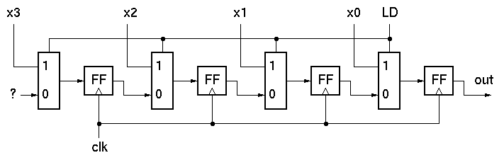
Sequential Logic
//Parallel to Serial converter
module ParToSer(LD, X, out, CLK);
input [3:0] X;
input LD, CLK;
output out;
reg out;
reg [3:0] Q;
assign out = Q[0];
always @ (posedge CLK)
if (LD) Q=X;
else Q = Q>>1;
endmodule // mux2
module FF (CLK,Q,D);
input D, CLK;
output Q; reg Q;
always @ (posedge CLK) Q=D;
endmodule // FF
Notes:
“always @ (posedge CLK)” forces Q register to be rewritten every simulation cycle.
“>>” operator does right shift (shifts in a zero on the left).
Shifts on non-reg variables can be done with concatenation:
wire [3:0] A, B;
assign B = {1’b0, A[3:1]}

Slide 58
Testbench
Top-level modules written specifically to test sub-modules. Generally no ports.
module testmux;
reg a, b, s;
wire f;
reg expected;
mux2 myMux (.select(s), .in0(a), .in1(b), .out(f));
initial
begin
s=0; a=0; b=1; expected=0;
#10 a=1; b=0; expected=1;
#10 s=1; a=0; b=1; expected=1;
end
initial
$monitor(
"select=%b in0=%b in1=%b out=%b, expected out=%b time=%d",
s, a, b, f, expected, $time);
endmodule // testmux
Notes:
initial block similar to always except only executes once (at beginning of simulation)
#n’s needed to advance time
$monitor - prints output
A variety of other “system functions”, similar to monitor exist for displaying output and controlling the simulation.

Slide 59
Final thoughts
Verilog looks like C, but it describes hardware
Multiple physical elements, Parallel activities
Temporal relationships
Basis for simulation and synthesis
figure out the circuit you want, then figure out how to express it in Verilog
Understand the elements of the language
Modules, ports, wires, reg, primitive, continuous assignment, blocking statements, sensitivity lists, hierarchy
Best done through experience
Behavioral constructs hide a lot of the circuit details but you as the designer must still manage the structure, data-communication, parallelism, and timing of your design.

